Slide 1
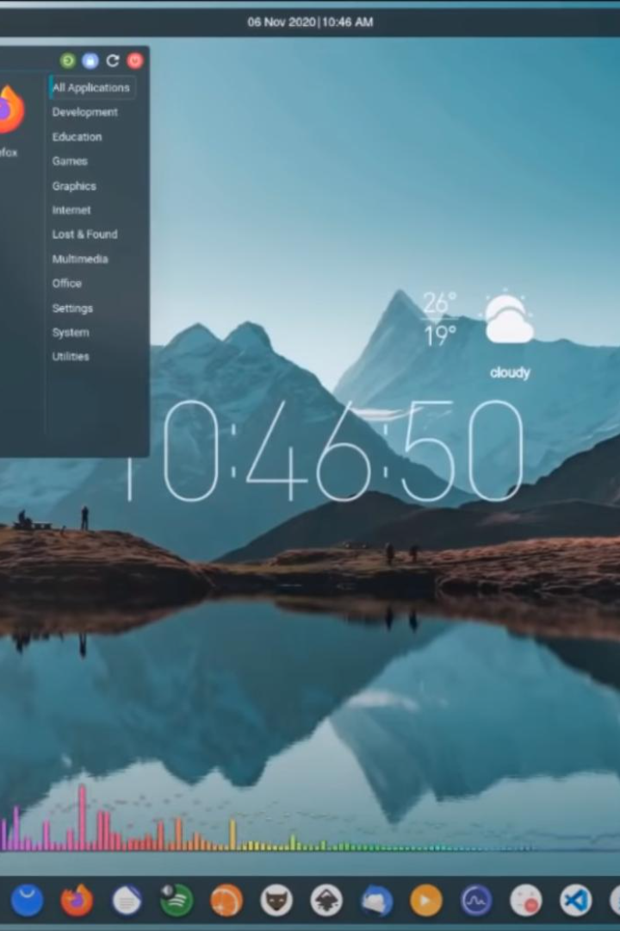


Linux File Management Commands
Master the essential commands for navigating and manipulating files and directories in a Linux or Unix-based operating system. Learn how to list files, create directories, copy and move files, change permissions, and more.
by Gangappa Malige

Slide 2

1. ls - List Files and Directories
View all files and directories in the current directory with the ls command. Quickly navigate through your file system and easily identify the contents.
$ ls
Desktop Documents Downloads Music Pictures Videos

Slide 3

2. pwd - Print Working Directory
Never lose track of your location in the file system. Use pwd to instantly display the path to your current working directory.
$ pwd
/home/username

Slide 4

3. cd - Change Directory
Easily switch between directories using the cd command. Save time and quickly access the files you need without navigating through the entire file system.
$ cd
Documents

Slide 5

4. mkdir - Make Directory
Create new directories effortlessly with mkdir. Organize your files efficiently and tailor your file system to meet your needs.
$ mkdir NewDirectory

Slide 6

5. rmdir - Remove Directory
Remove empty directories with the rmdir command. Keep your file system clean and tidy by deleting unnecessary directories.
$ rmdir NewDirectory

Slide 7

6. touch - Create Empty File
Generate an empty file instantly using touch. Get started on your projects without hassle, saving time and effort.
$ touch myfile.txt

Slide 8

7. cp - Copy
Clone files or directories effortlessly with the cp command. Make backups, duplicate important files, or move data between locations.
$ cp file1.txt file2.txt

Slide 9
8. mv - Move
Rename or move files and directories using mv. Organize your files and easily update file names or relocate them within your system.
$ mv file1.txt new_location/

Slide 10

9. rm - Remove
Delete files or directories using rm. Free up space, remove unnecessary files, and keep your file system optimized.
$ rm file.txt

Slide 11
10. find - Find Files
Need to locate a specific file or directory? The find command enables you to search your system and locate files based on specific criteria.
$ find /path/to/search -name myfile.txt

Slide 12

11. chmod - Change Permissions
Take control of file permissions using chmod. Protect sensitive files and ensure the right level of access for each user or group.
$ chmod 644 myfile.txt

Slide 13
12. chown - Change Ownership
Manage file ownership effortlessly with chown. Assign files to different users and groups, ensuring the right level of responsibility and control.
$ chown username:groupname myfile.txt

Slide 14

13. df - Disk Free
Monitor your disk space usage with the df command. Gain insights into available disk space, enabling you to effectively manage your storage.
$ df -h

Slide 15

14. du - Disk Usage
Understand the disk space consumed by files and directories using du. Identify space-consuming files and optimize your storage usage.
$ du -sh directory/

Slide 16

15. ln - Create Links
Create hard or symbolic links to files using ln. Efficiently reference and access files without duplicating them, saving storage space.
$ ln -s myfile.txt mylink.txt

Slide 17
16. cat - Concatenate and Display File
Access and display the contents of a file using cat. Easily view file content and verify data without opening complex editors.
$ cat myfile.txt

Slide 18
Thank You
Thank you for your attention and for taking the time to go through our presentation. We hope you found it informative and engaging. If you have any questions or would like to learn more, please don't hesitate to reach out to us. We appreciate your interest!

